Slide 1

EXPLORING THE MAJOR BARRIERS AND FACILITATORS OF HEALTHCARE INFORMATICS ADOPTION IN HEALTHCARE DELIVERY BY NURSES AND PHYSICIANS
ESTHER EMALO ODU
19 December 2025

Slide 2
INTRODUCTION/BACKGROUND
HEALTHCARE INFORMATICS
Global integration of informatics in diverse healthcare environments is consistently increasing, as organizations perpetually provide care that incorporates knowledge and skills typically linked to technology (Salameh et al., 2019; Haleem et al., 2021)
Healthcare information systems (HIS, Informatics) encompass electronic health records, clinical decision support systems, and telehealth technology to support patient care.
The dynamics and technology-driven healthcare landscape necessitate that healthcare professionals employ informatics to provide safe, effective, and high-quality care(WHO, 2019)
Nevertheless, Health informatics, although frequently linked to enhanced patient care and service delivery, continues to encounter resistance and variability in its adoption and utilization among nurses and doctors (Reid et al., 2021; Hovenga, 2022).

Slide 3
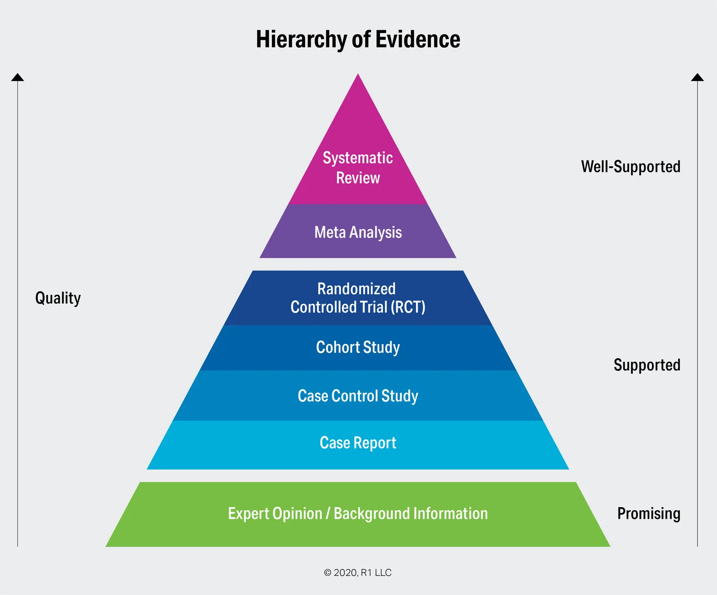
PROBLEM STATEMENT
CURRENT KNOWLEDGE
The prevailing understanding of the reason behind informatics inconsistency and reluctance is frequently disjointed or context-dependent.
A thorough synthesis that integrates such facilitators and barriers to informatics adoption across diverse contexts remains lacking. Thus, the rationale for conducting this study.
This study was a systematic review. Systematic review research is located at the apex of the evidence-based practice research pyramid. It represents the highest level of evidence because it synthesizes findings from multiple relevant primary studies to provide a comprehensive, unbiased summary of current research on the informatics major barriers and facilitators.

Slide 4
RESEARCH AIM
This study aimed to systematically review and explore major barriers and facilitators that influence Nurses and Physicians’ Adoption and Implementation of Informatics in Healthcare delivery
Research Objectives
To systematically identify and synthesize existing literature on the barriers and facilitators of integrating informatics into healthcare delivery systems, enabling an evidence-based discovery of barriers and facilitators faced by nurses and physicians during care delivery
To explore and categorize key barriers and facilitators through in-depth analysis of real-world experience.
To evaluate the impact of identified barriers and facilitators and different healthcare delivery aspects, thereby enabling evidence-based recommendations to improve integration by nurses and doctors in clinical settings
RESEARCH QUESTION
What are the Major Barriers and Facilitators of the Adoption and Implementation of health informatics in healthcare delivery by Nurses and Physicians?

Slide 5
METHODOLOGY
DATABASE EXPLORED
PubMed
Cochrane Library
Scopus
Web of Science
CINAHL
RESEARCH DESIGN
Systematic Review Study
INCLUDED REVIEW STUDY LIST
Bimerew (2024) Quantitative studies carried out in South Africa
Bekele et al. (2024): Qualitative study conducted in Ethiopia
Colins, Babu & Honey (2024): Qualitative study conducted in New Zealand
Alzghaibi (2024): Quantitative study conducted in Saudi Arabia
Alrasheeday et al. (2023): Cross-sectional quantitative study carried out in Saudi Arabia
Olorunfemi et al. (2020): Mixed-method study carried out in Nigeria
Nouira & Souaayah (2024): Quantitative studies carried out in Tunisia
Infinde (2018): Quantitative studies, done in Canada
Liberati et al.(2017): A Qualitative study conducted in Italy
Hashemi et al. (2020): A Qualitative research study carried out in Iran.
Analysis methods
Thematic analysis for the qualitative data
Convergent translation of quantitative data.
Triangulation for verification with qualitative insights
Numerical codes systematic assignment to Likert scale (yes=1, 0=no, male=1, female=2, others=3)
2. Discussion – Virus, a mortal enemy

Slide 6
RESULTS/FINDINGS (The New Conceptual Framework Developed in this study
THEMES DEVELOPED
Major Themes | Sub-Themes
INDIVIDUAL BARRIERS & FACILITATORS | 1)Perceived usefulness
 | 2)Perceived ease of use
 | 3)Psychological Readiness
 | 4)User motivation & Attitude
TECHNOLOGICAL BARRIERS AND FACILITATORS | 1)Digital Literacy & Competence
 | 2)Connectivity & Security
 | 3)System complexity & Usability
ORGANISATIONAL BARRIERS AND FACILITATORS | 1)Infrastructures & Accessibility 2)Training & Support 3)Sustainability 4)Organizational policy 5)Workload & Time 6)Non-adoption & Spread
Hierarchy OF BARRIERS &FACILITATORS
INDIVIDUAL (100%)
ORGANISATIONAL (80%)
TECHNOLOGICAL (70%)
RELATIONSHIP OF BARRIERS & FACILITATORS
Individual B&F
Organizational B&F
Technological B&F

Slide 7
DISCUSSION
The study, in general, did not present any findings that refute the research question. Findings from all the study articles provided robust support for the research inquiry. The findings align with and support the research findings by identifying major obstacles and enablers. While individual factors reveal prevalent person-related elements, organizational readiness and support dictate the success or failure of information implementation. Furthermore, the influence of systemic and technological inequities, as detailed in these studies, reinforces and substantiates the research question.
This study result exhibits a robust correlation with the Technology Acceptance Model (TAM) (Davis 1989). This is because adoption was influenced by perceived clinical value, system efficiency, and interface simplicity.
Infrastructure readiness, organizational culture, and policy align with the NASS (Non-adoption, Abandonment, Scale-up, Spread, and Sustainability) domain of technology, value proposition, adopters, and the organizations.
Esteemed health organizations like the WHO, the Commonwealths, and the Ministry of Health, Seychelles, support health informatics.
.

Slide 8
CONCLUSION
This systematic review’s findings emphasized the multifactorial influences on the adoption of health information, encompassing individual, organizational, and technological elements. Findings exhibit strong alignment with technological theories and global health policies.
Although various factors influence the adoption of informatics, barriers remain predominant, particularly in low-to middle-income countries.
The findings of this review present a foundational conceptual framework that illustrates the dynamic interplay among individual readiness, technological quality, and organizational support in influencing the adoption of health informatics by nurses and doctors.
Successful adoption is contingent not only upon system design but also on leadership support, staff training, organizational culture, and consistent policies aimed at mitigating challenges
This finding thereby serves as a guide for future policy, training, and system design improvement.
2. Discussion – Virus, a mortal enemy
.

Slide 9
LIMITATIONS
  This review limitation encompasses restricted geographical representation, variability of methodology, deficient participant demographics in some research studies, and concentration only on peer review studies, thereby neglecting expert opinion or informal evaluation.
  Although systematic, the process of coding and synthesis entails a lot of skills, knowledge, time, energy, and effort. However, despite attempts to anchor themes in a theoretical framework, subjective assessment may result in potential bias due to the presence of an individual reviewer.
2. Discussion – Virus, a mortal enemy
.

Slide 10
RECOMMENDATIONS FOR FUTURE WORK
This systematic review conceptual framework underscores the necessity of a multifaceted system-thinking approach to healthcare informatics integration. Addressing these obstacles and enhancing facilitators necessitates investment in capacity development, system architecture, and participatory leadership to guarantee sustainable and equitable integration in clinical practices and settings.
Extensive research with enhanced methodological rigor, wider geographical representation is recommended. However, such research must incorporate an organizational strength-based perspective.
There is a necessity for transparent clinical engagement and audit trails in informatics development. This enables users’ comprehension and trust development in the system.
Training is not a singular event but a continuous endeavor to augment proficiency and assurance within the system.
.

Slide 11
Thank you
I HAVE A DREAM & SO DO YOU, THEREBY JUSTIFYING THE REASON WE ARE ALL HERE

